Slide 1


2024 HCA Single-Cell Omics in-person Computational and Experimental Design Workshop Inferring trajectories from scRNA-Seq data
June 24-28, 2024
Bangkok, Thailand

Slide 2
Computational track schedule
 | Beginner | Advanced
Monday | Preprocessing/QC | Data integration/cell type annotation/DE
Tuesday | Clustering/DE/data integration/cell type annotation | multi-omics/DA
Wednesday | TCR/BCR/CITE-Seq
Thursday | Trajectory inference/cell-cell communication
Friday | project/presentation

Slide 3


Got questions? Fill out here: https://forms.gle/9BwebSJn4VLgoxme9
Feedback form for staff: https://tinyurl.com/hca-asia-feedback

Slide 4
Outline: Inferring trajectories
What does it mean to infer a trajectory?
How to infer trajectories.
How to infer pseudotime.
How to identify genes that are differentially expressed along a trajectory.

Slide 5
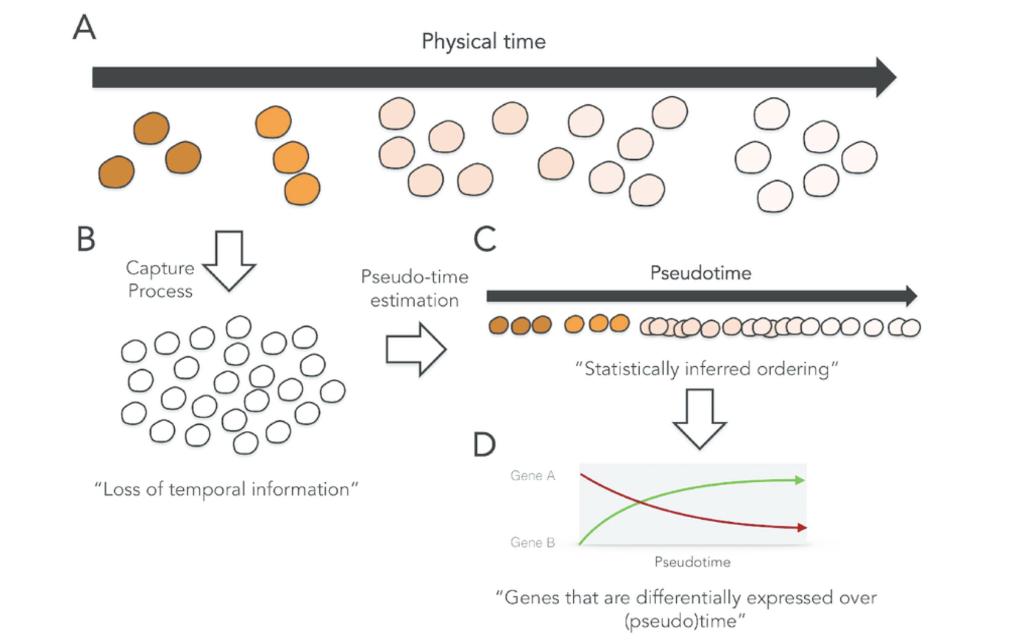
Reconstructing trajectories from scRNA-Seq measurements
-
In single-cell expression studies of
processes such as cell differentiation,
captured cells may be widely
distributed in terms of progress.
-
In a population of cells captured at
the same time, some cells might be
far along, while others might not yet
have begun the process.

Slide 6
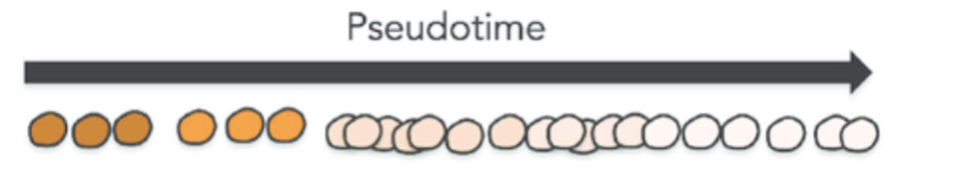
Defining pseudotime along a trajectory
Pseudotime is a measure of how much progress an individual cell has made through a process (such as cell differentiation).
Pseudotime is an abstract unit of progress: it's simply the distance between a cell and the start of the trajectory, measured along the shortest path
The trajectory's total length is defined in terms of the total amount of transcriptional change that a cell undergoes as it moves from the starting state to the end state.
http://cole-trapnell-lab.github.io/monocle-release/docs/#constructing-single-cell-trajectories

Slide 7
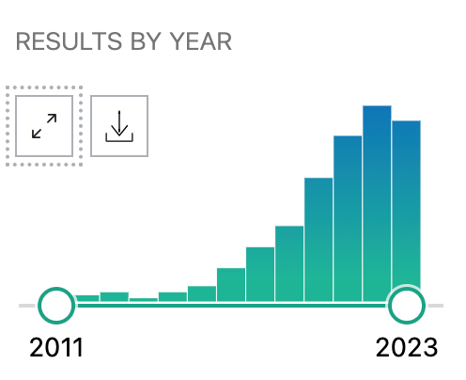
There are many trajectory inference tools!
Pubmed results for “trajectory inference method single-cell”
70
0

Slide 8
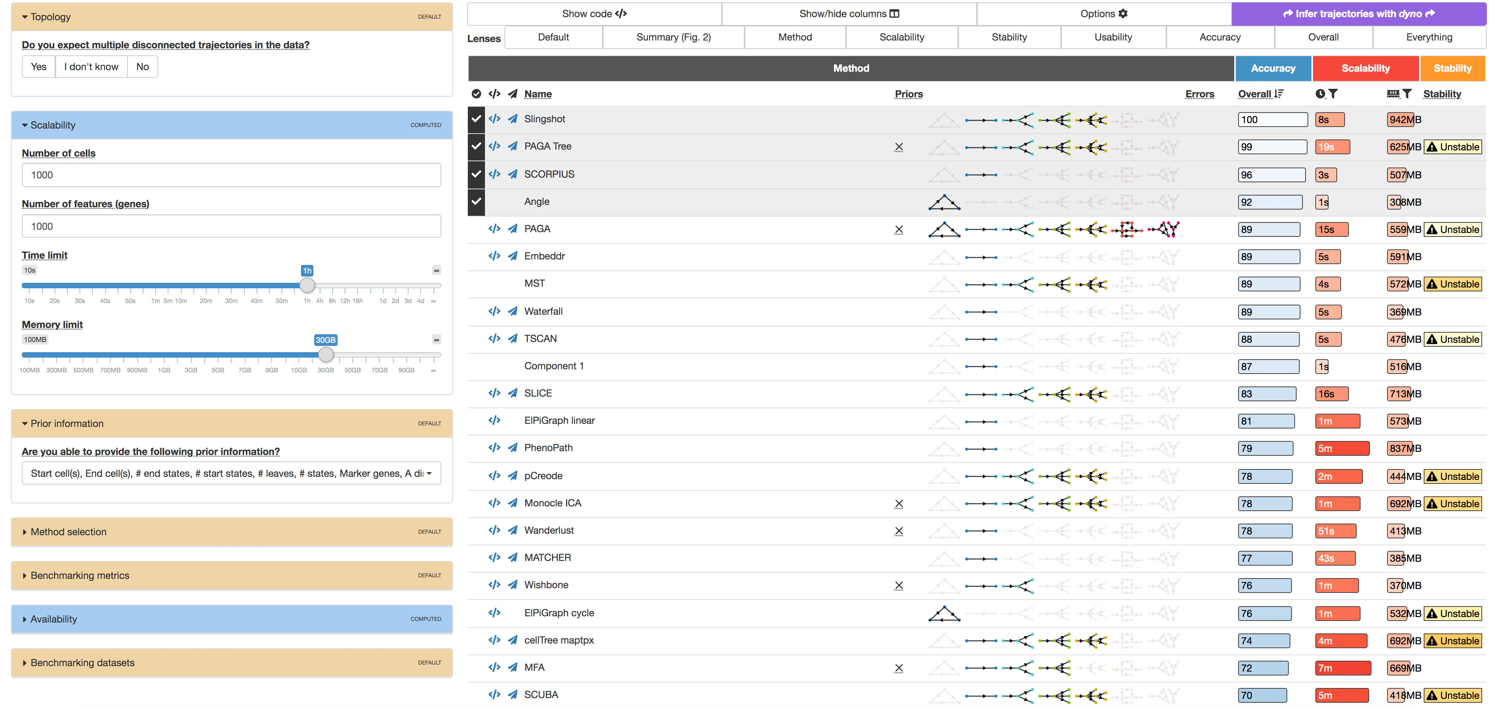
Comparisons of trajectory inference tools
Dynverse lets you infer and compare trajectories using multiple algorithms.
guidelines.dynverse.org Saelens W. et al. (2019) Nature Biotechnology.

Slide 9
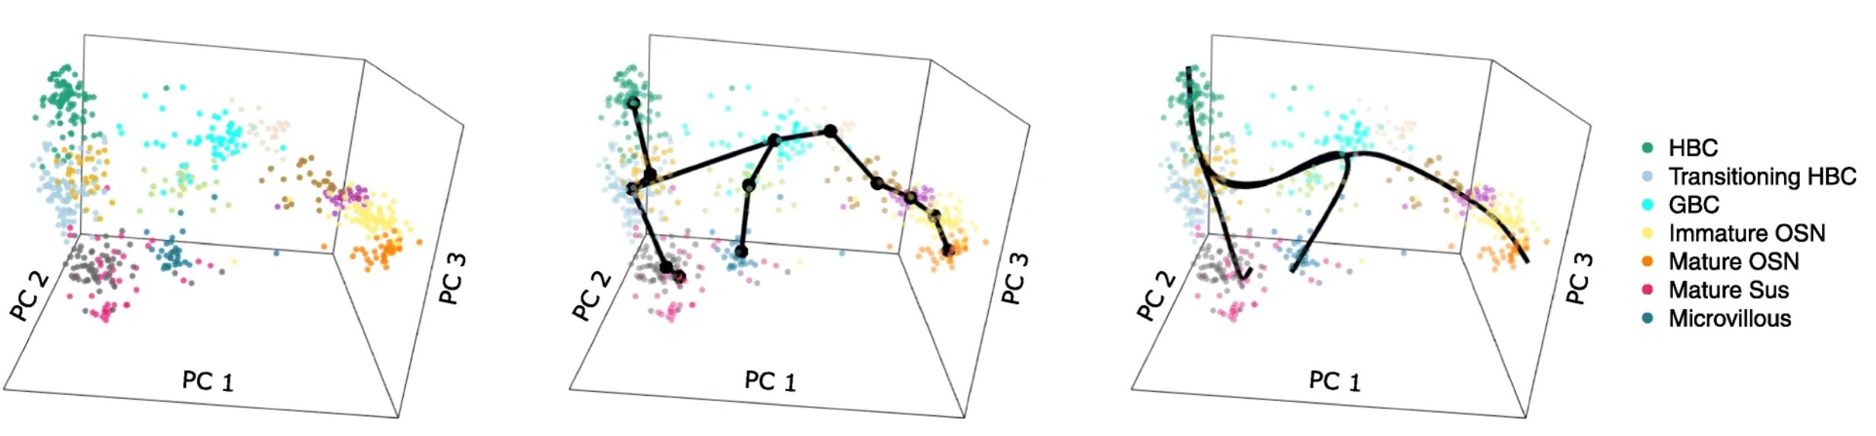
Slingshot is one of the most widely used and robust approaches to infer trajectory
Cluster scRNA-Seq data in a low-dimensional space.
Building a minimum spanning tree (MST) on the clusters.
Fit principal curves through the MST.
Street K. et al. (2018) BMC Genomics.

Slide 10
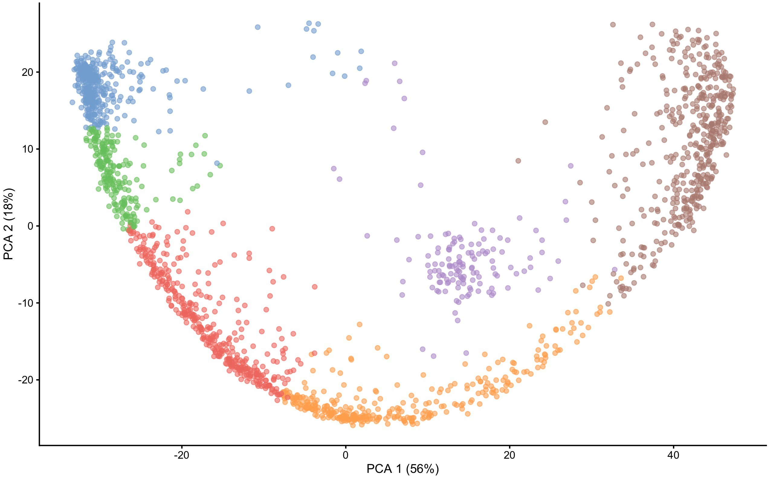
Building a minimum spanning tree
1. Build a graph with edges between each pair of clusters.
Street K. et al. (2018) BMC Genomics.

Slide 11




Building a minimum spanning tree
Build a graph with edges between each pair of clusters.
Add weights to each edge according to proximity of the two clusters.
Street K. et al. (2018) BMC Genomics.

Slide 12
Building a minimum spanning tree
Build a graph with edges between each pair of clusters.
Add weights to each edge according to proximity of the two clusters.
Find the shortest path between clusters.
Street K. et al. (2018) BMC Genomics.

Slide 13
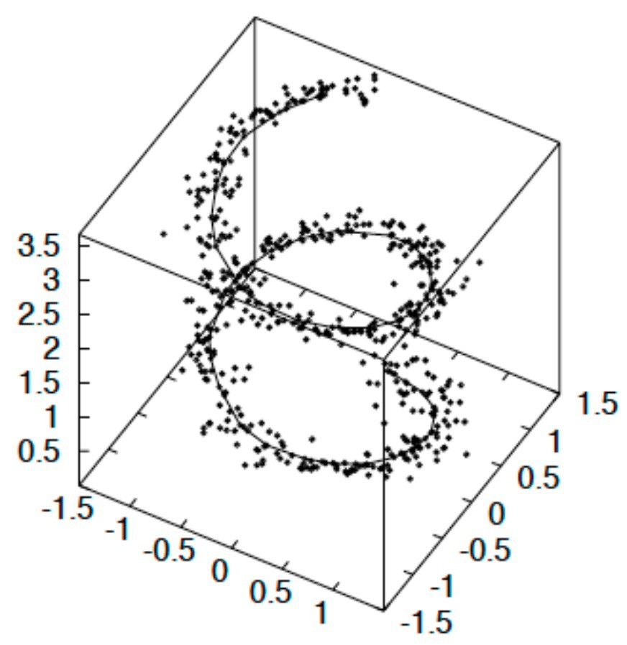
Fitting principal curves to tree and measuring pseudotime
A principal curve is a smooth, one-
dimensional curve that passes through the middle of a high-dimensional data set, providing a nonlinear summary of the data.
Hastie T. et al. (1989) Journal of the American Statistical Association.

Slide 14
Fitting principal curves to tree and measuring pseudotime
A principal curve is a smooth, one-
dimensional curve that passes through the middle of a high-dimensional data set, providing a nonlinear summary of the data.
Street K. et al. (2018) BMC Genomics.

Slide 15
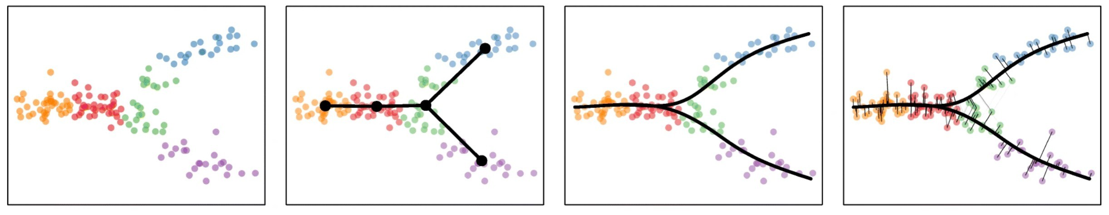
Fitting principal curves to tree and measuring pseudotime
In Slingshot, the pseudotime values are estimated as the Euclidean distance from each point to the closest principal curve (i.e. by orthogonal projection of each point onto the curve).

Slide 16
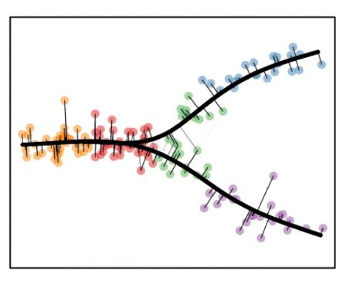
Which cell came first? How is a trajectory oriented?
In most trajectory inference algorithms, the trajectory is not a vector as it lacks an orientation!
or
We typically need prior biological knowledge (e.g. stem cell…) to provide a root to the inferred trajectory.

Slide 17
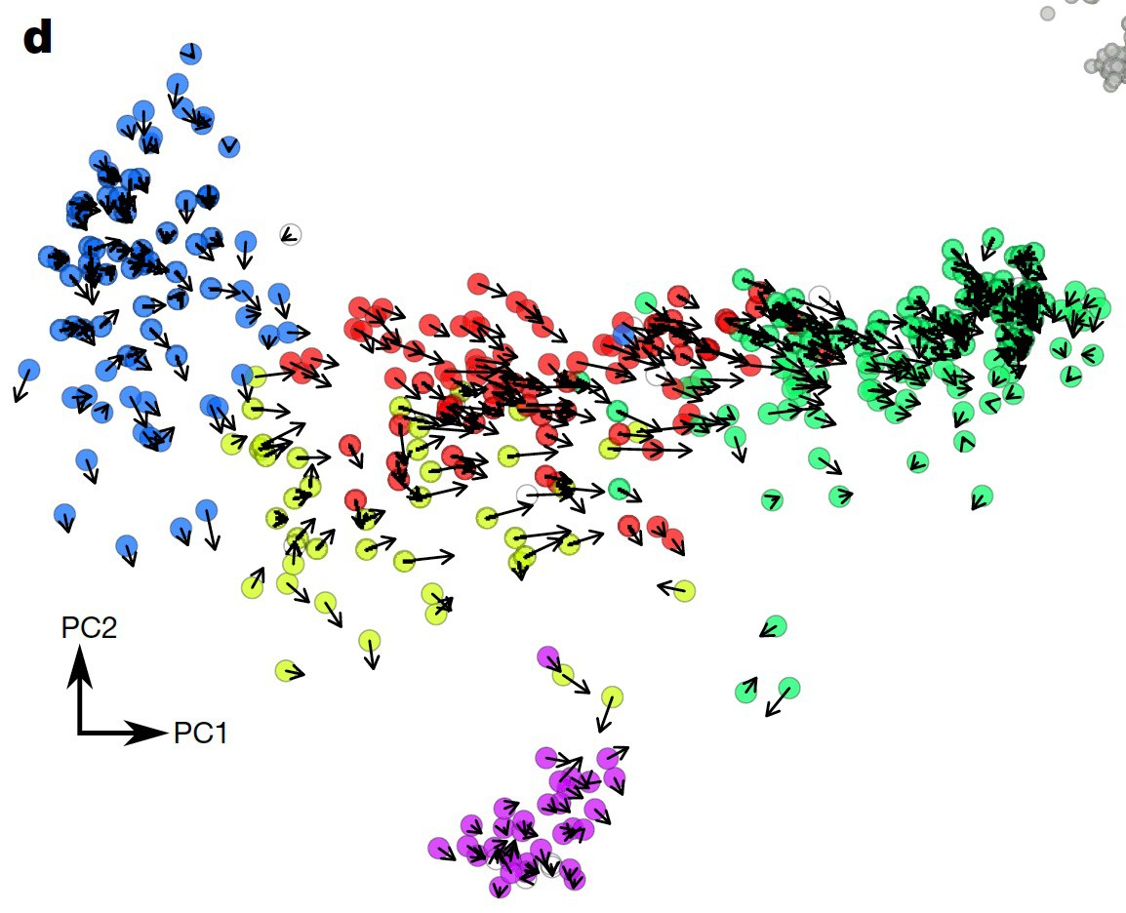
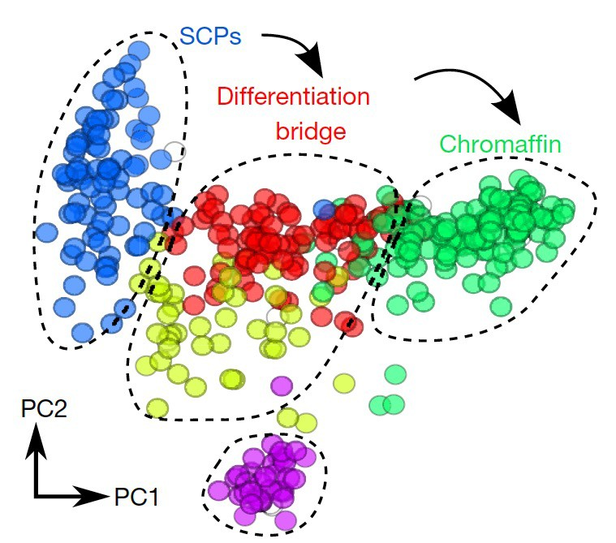
RNA velocity: predicting the future state of individual cells
RNA velocity
Time derivative of the gene expression state.
High-dimensional vector that predicts the future state of individual cells on a timescale of hours.
The inferred trajectory has a direction for each cell!
Schwann cell precursors (SCPs) differentiating into chromaffin cells in embryonic day (E)12.5 mice
La Manno G. et al. (2018) Nature.

Slide 18
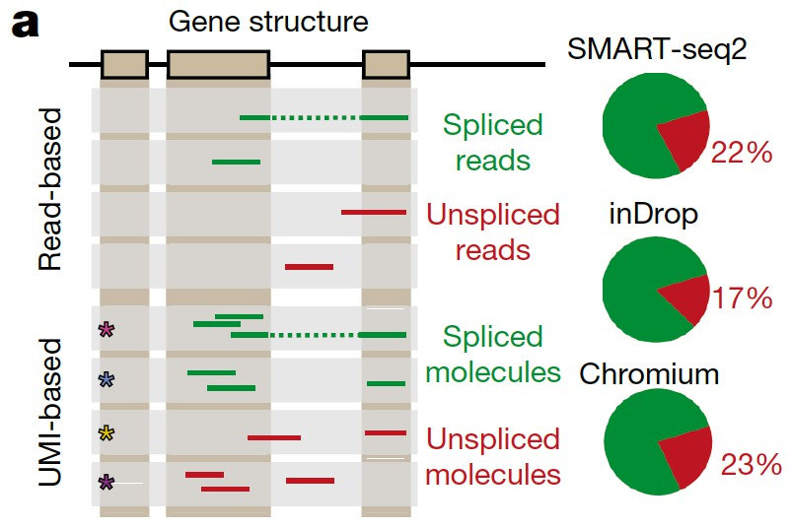
RNA velocity: predicting the future state of individual cells
RNA velocity
Time derivative of the gene expression state.
High-dimensional vector that predicts the future state of individual cells on a timescale of hours.
Directly estimated by distinguishing between unspliced and spliced mRNAs in scRNA-Seq sequencing reads.
La Manno G. et al. (2018) Nature.

Slide 19
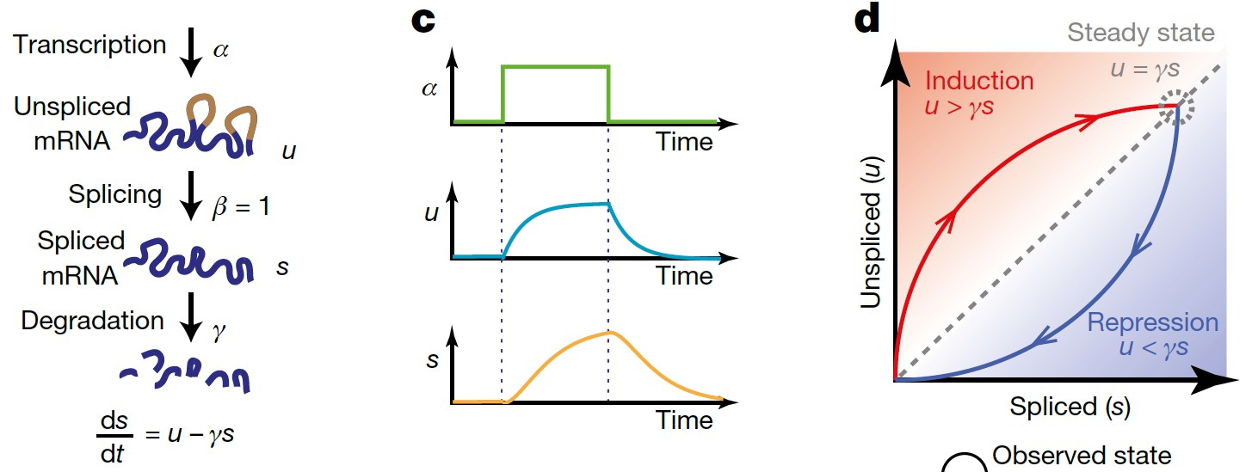
RNA velocity: modeling transcriptional dynamics
The time derivative of the spliced mRNA abundance (RNA velocity).
Balance between production of spliced mRNA from unspliced mRNA and mRNA degradation.
Central assumption is that transcription is at steady state
(violated in many cases, e.g. differentiation).
La Manno G. et al. (2018) Nature.

Slide 20
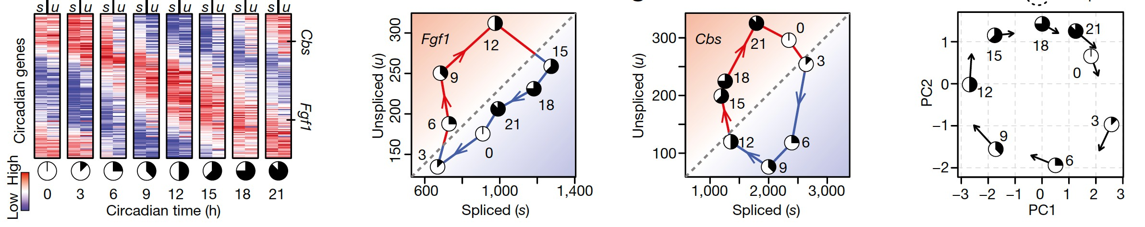
RNA velocity: example with circadian-associated genes
Circadian-associated genes in mouse liver measured over 24 hours.
Fgf1 and Cbs are two circadian-driven genes.
Transcriptional dynamics of
Bulk RNA-Seq of circadian cycle in mouse liver
Future expression state
individual genes predicted by RNA velocity
La Manno G. et al. (2018) Nature.

Slide 21
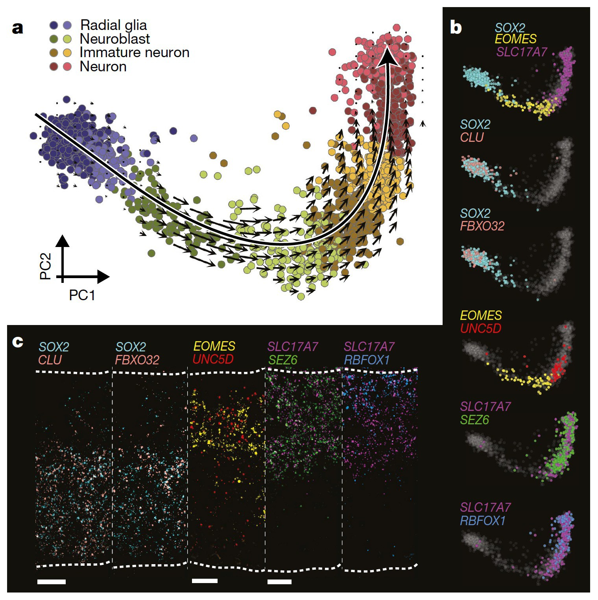
RNA velocity: example with human embryonic glutamergic neurogenesis (10 weeks p.c.)
Mature differentiated
Proliferating progenitor
RNA velocity and pseudotime from fitting a principal curve
Gene expression of known markers
RNAscope (fluorescence in situ hybridization)
La Manno G. et al. (2018) Nature.

Slide 22
Important follow-up studies in trajectory inference and pseudotime
Follow-up studies to RNA velocity:
Bergen, V. et al. "Generalizing RNA velocity to transient cell states through dynamical modeling." Nature biotechnology (2020).
Li, C. et al. “Multi-omic single-cell velocity models epigenome–transcriptome interactions and improves cell fate prediction.” Nature biotechnology (2022).
Qiu, X. et al. “Mapping transcriptomic vector fields of single cells.” Cell (2022).
Lange, M. et al. “CellRank for directed single-cell fate mapping.” Nature Methods (2022).
Gayoso, A. et al. “Deep generative modeling of transcriptional dynamics for RNA velocity analysis in single cells.” Nature biotechnology (2023).
Gorin, G. et al. “RNA velocity unraveled.” PLoS Computational Biology (2022).
Follow-up studies to Slingshot:
Cao, J. et al. “The single-cell transcriptional landscape of mammalian organogenesis.” Nature
(2019).

Slide 23
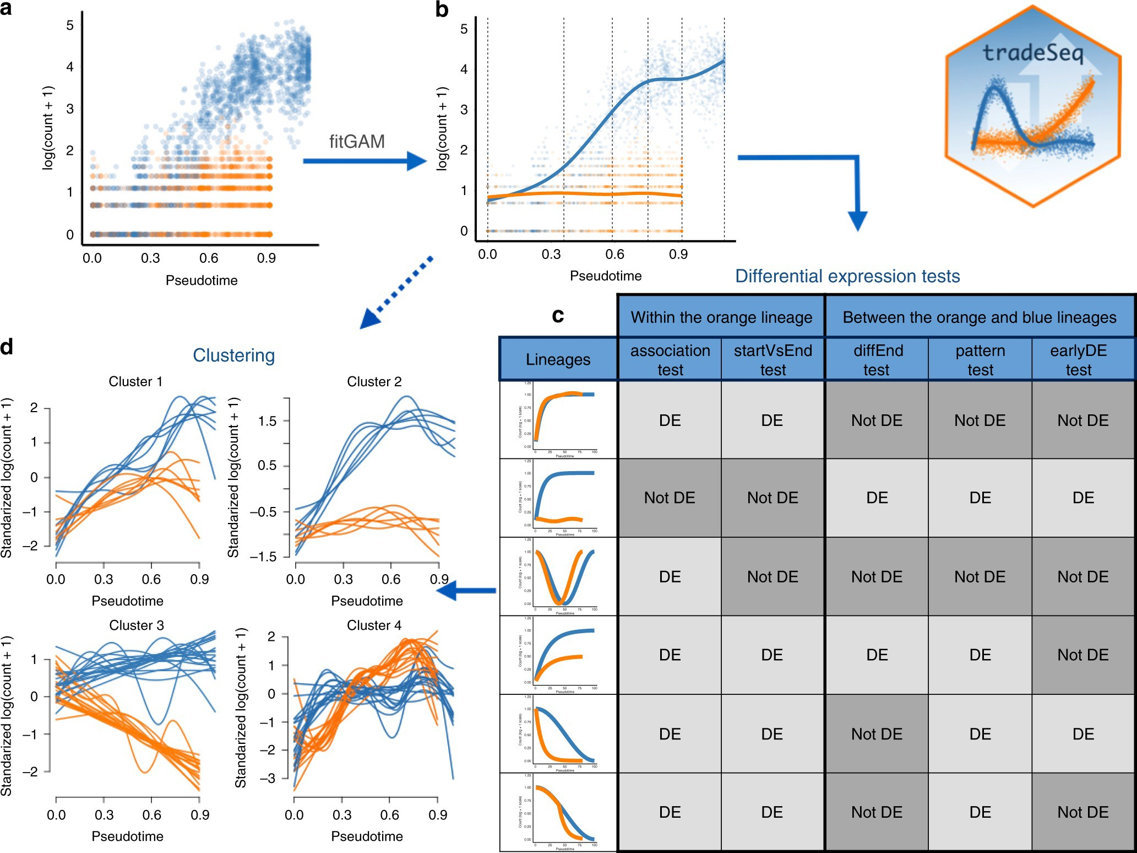
Discovering genes associated with the lineages in the trajectory, or differentially expressed between lineages
For each gene, plot a cell’s position in pseudotime (x-axis) vs the expression of the gene in the cell.
Model time-dependent expression by fitting a negative binomial generalized additive model (GAM) to gene expression~pseudotime.
DE gene analysis within a lineage and between lineages.
Van den Berge, K. et al. (2020) Nature Communications.

